Slide 1
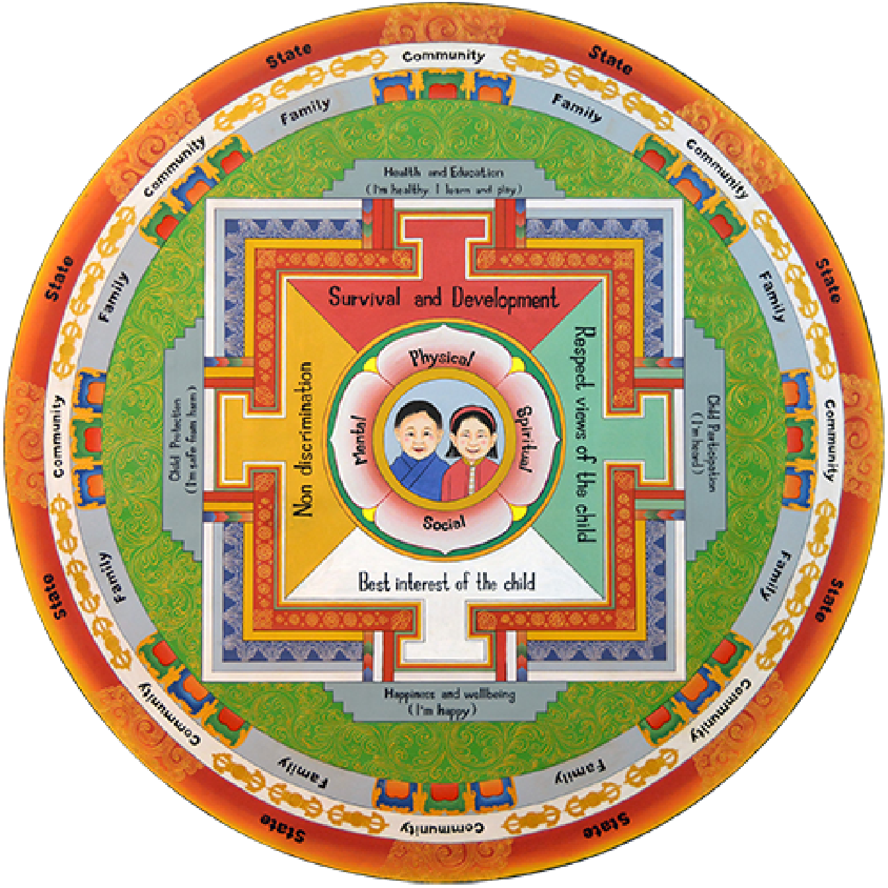
Child Mandala App
A Mobile Platform for Child Care & Parenting Support in Bhutan
Presented by aBit Soft

Slide 2
The Challenge: Why This Matters Now
Rising Social Challenges
The Opportunity
Mental health concerns among youth
Increased screen time and digital exposure
Nutrition deficiencies
Violence against children
Online safety threats
85% mobile penetration in Bhutan
Technology can bridge the gap at scale, reaching families across the country with trusted, localized content.
Gaps in Parenting Support
Limited access to evidence-based guidance
Rural families underserved
Need for culturally appropriate content

Slide 3
Our Vision
Mission: Leverage mobile technology to deliver child protection awareness and age-appropriate parenting content to every family in Bhutan.
Core Pillars
1
2
3
4
Prevention
Awareness
Access
Convergence
Educate before issues arise
Evidence-based guidance at scale
Available to all communities
Unite all sectors

Slide 4
Target Users: Who We Serve
Expecting Parents
Parents of 0-17
Children
Community Workers
Need: Prenatal care guidance
Need: Age-specific parenting support
Need: Safe learning environment
Need: Tools for outreach
Solution: Pregnancy chapter with health tips
Solution: Content that adapts as children grow
Solution: Child-friendly mode with age-appropriate content
Solution: Events, resources, reporting
Reach potential: All families with smartphones across Bhutan

Slide 5
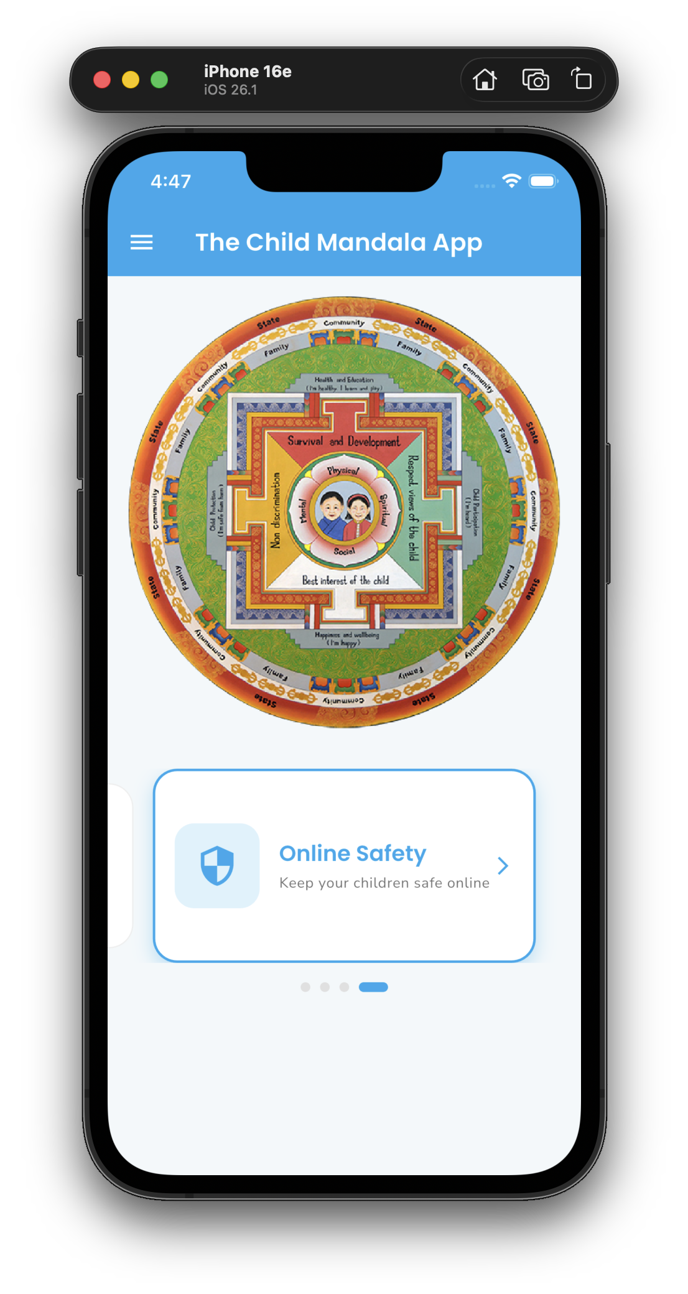
The Solution: Child Mandala App
Existing Features (Enhanced)
Interactive Mandala
News Portal
New Add-ons
Dual-user system (Parent + Child modes)
Phone + OTP & PIN authentication
ICAP parenting content (8 chapters)
Age-based content filtering
Online safety education (4 C's)
Community events & incident reporting
Bilingual support (EN + DZ)
Major Enhancement: AI Chatbot Integration

Slide 6
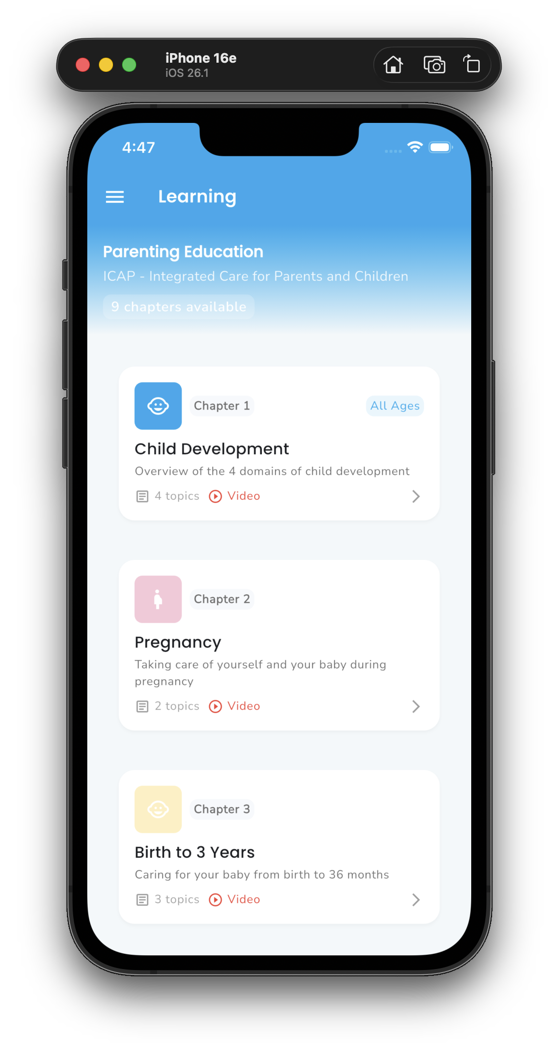
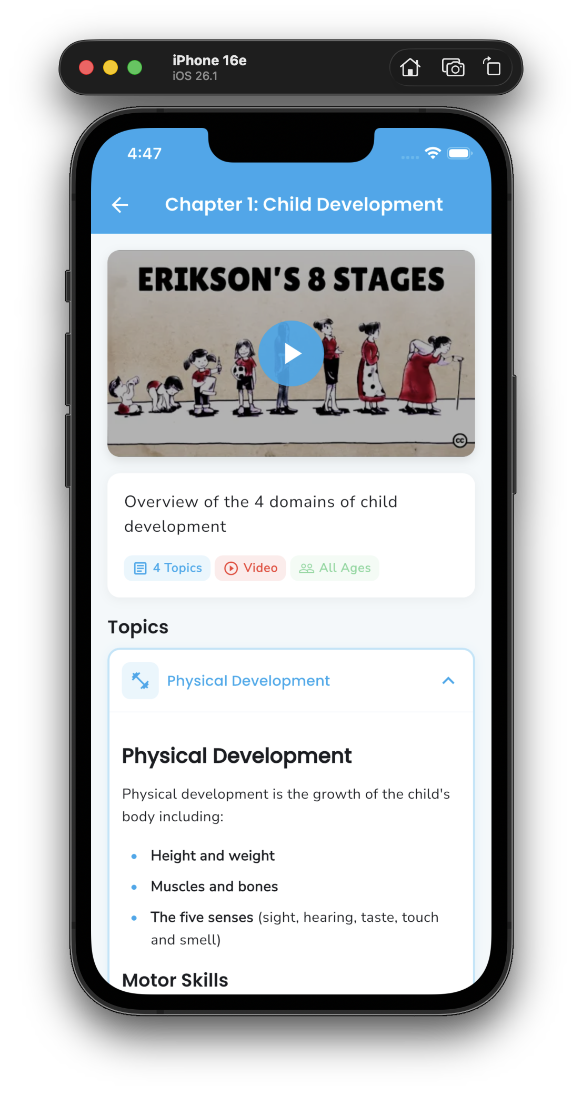
ICAP Content Framework
8 Comprehensive Chapters
1. Child Development Overview
2. Pregnancy & Prenatal Care
3. Birth to 3 Years
4. Preschool (3-5 Years)
5. Primary School (6-12 Years)
6. Adolescent/Teen (13-17 Years)
7. Cross-Cutting Issues
8. Self-Care for Parents
Smart Filtering: Content matches child's age

Slide 7
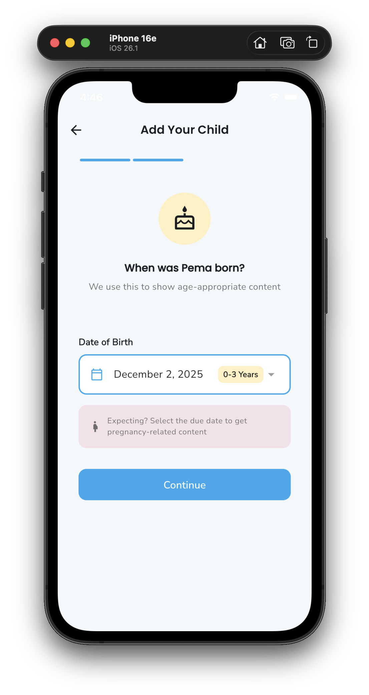
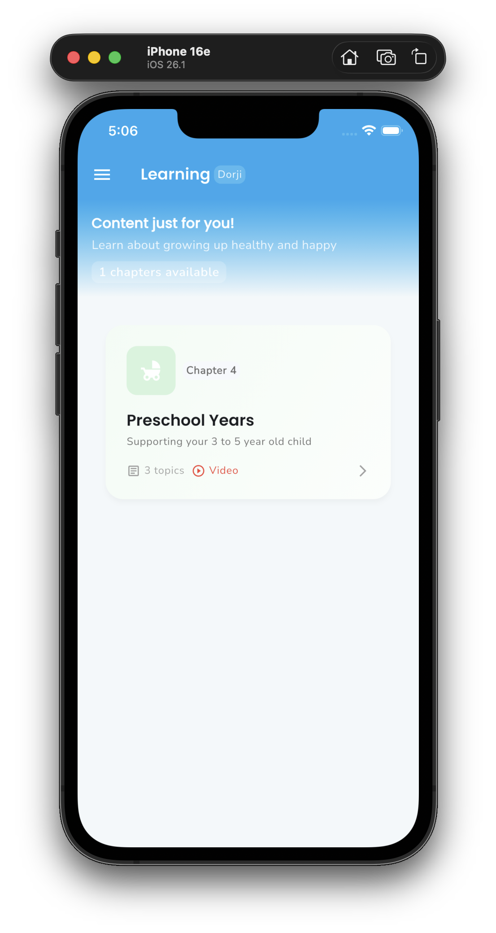
Age-Based Content Filtering
How It Works
1. Parent registers child with DOB
2. System calculates age group
3. Child sees only relevant content
Age Groups
Stage | Ages
Pregnancy | Expected
Infant | 0-3 yrs
Toddler | 3-5 yrs
Child | 6-12 yrs
Teen | 13-17 yrs

Slide 8
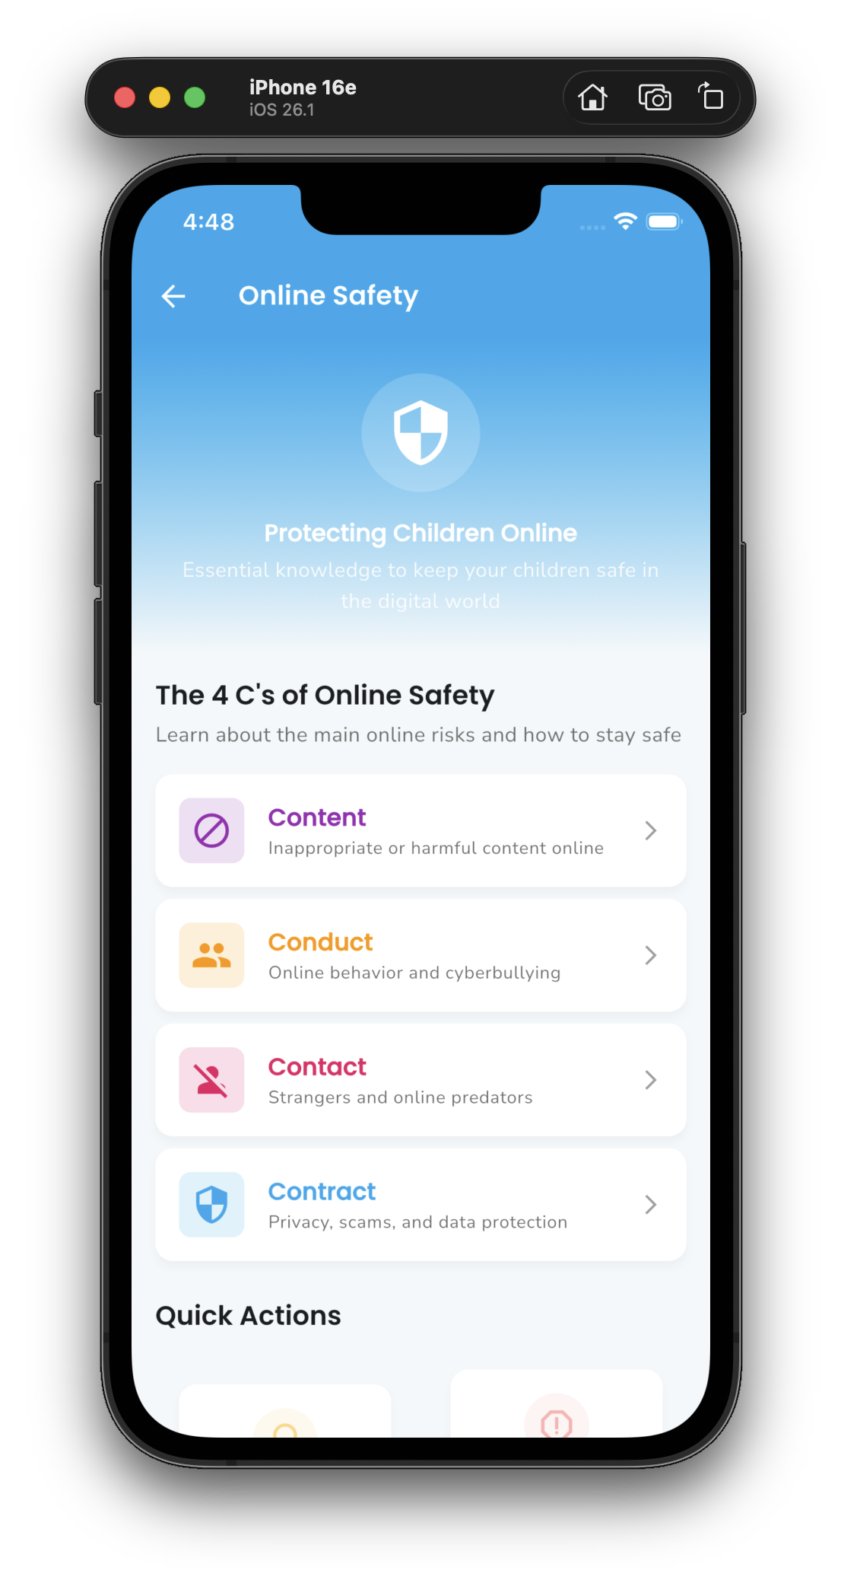
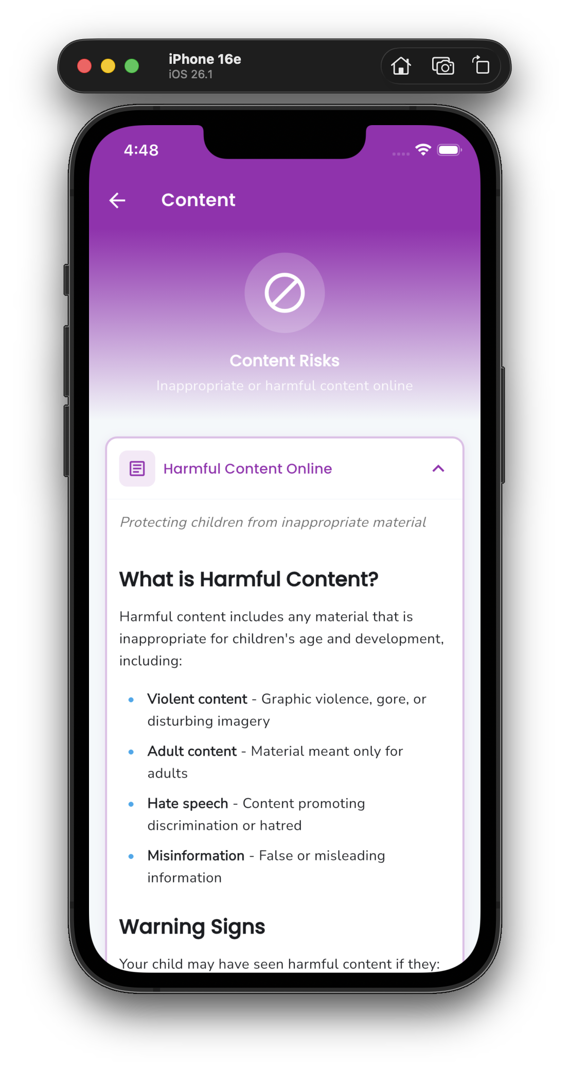
Online Safety: 4 C's Framework
Based on Bhutan's Cybersecurity Framework
Content
Harmful material protection
Conduct
Cyberbullying prevention
Contact
Stranger danger awareness
Contract
Privacy & data protection
Emergency: Police 113 | Child Helpline 1098

Slide 9
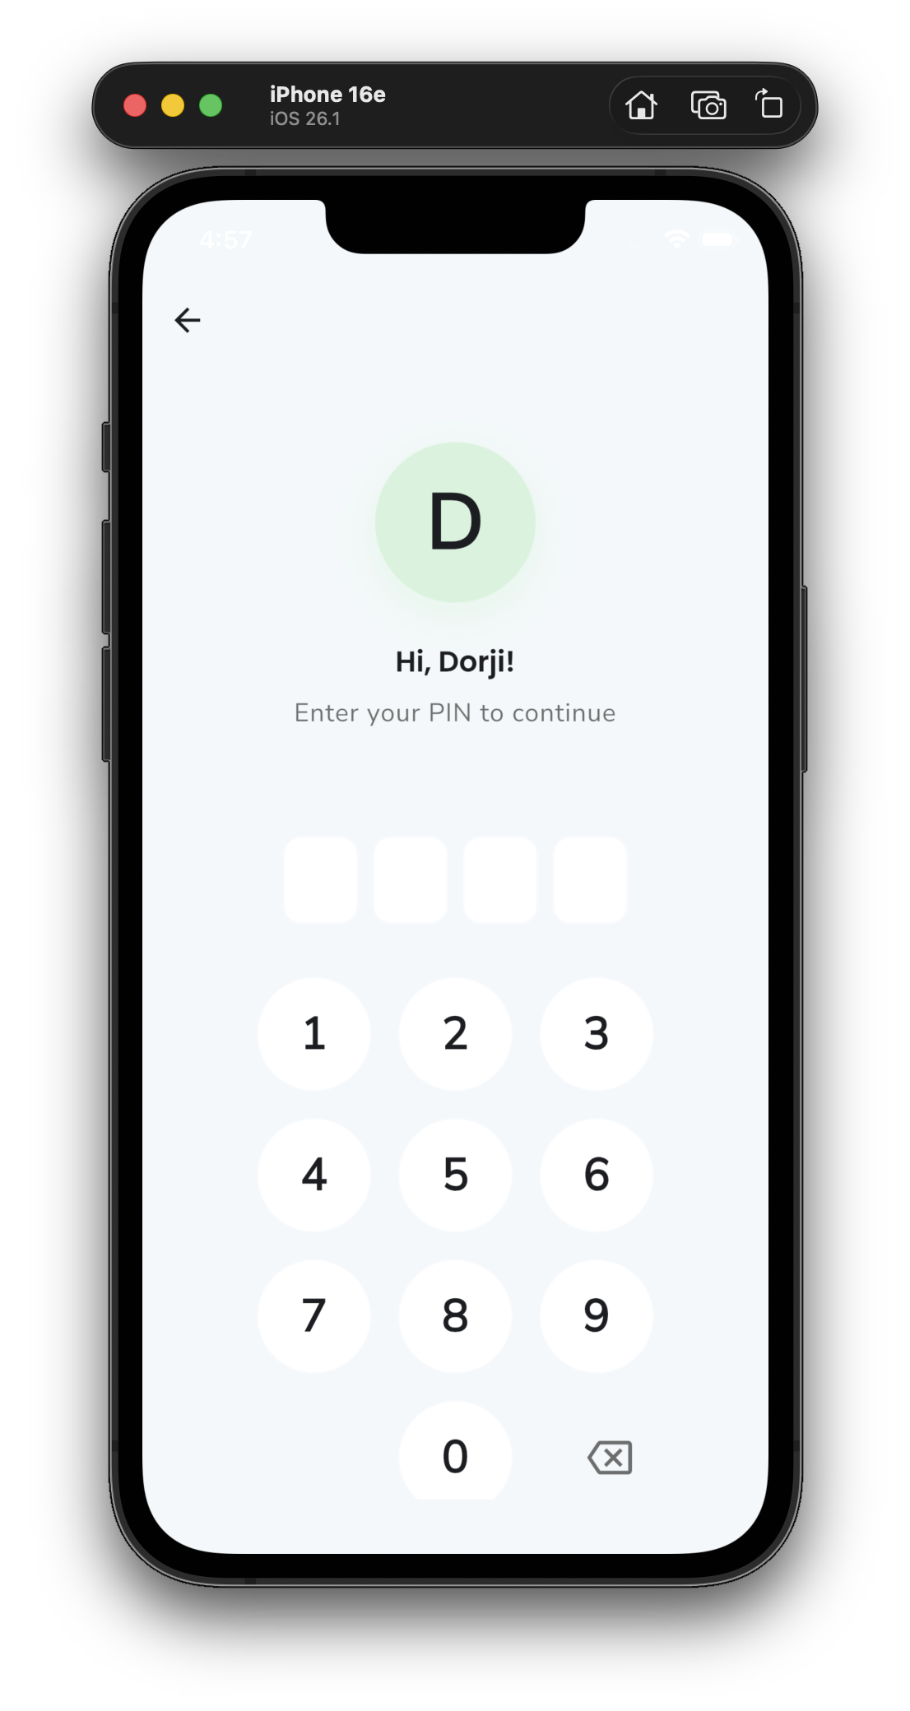
Child-Friendly Mode
Design Principles
Colorful pastel UI - Welcoming
Large touch targets - 60px+ buttons
Minimal text - Icon-driven navigation
Engaging animations - Fun interactions
Safe content only - Age-filtered
PIN Security
4-digit PIN per child
Secure, easy to remember
Prevents unauthorized access

Slide 10
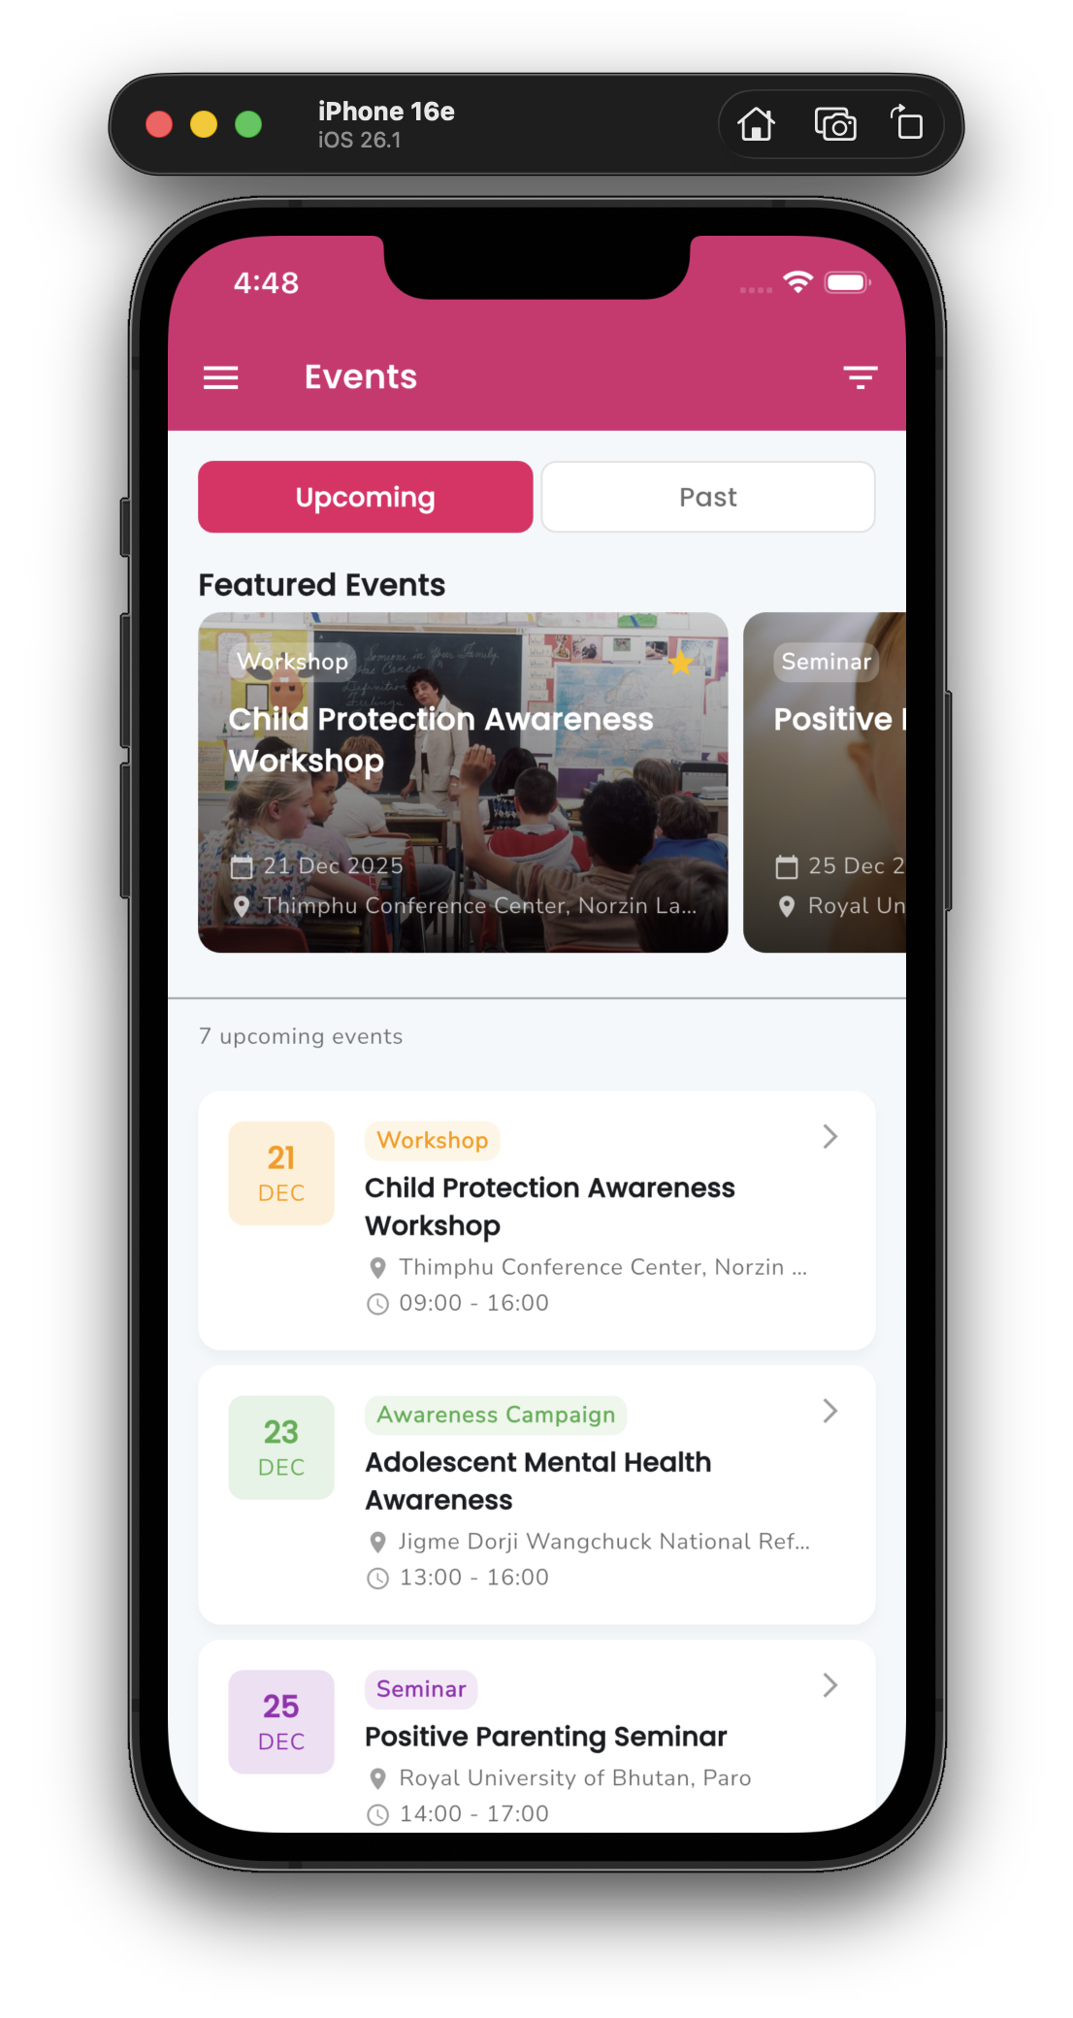
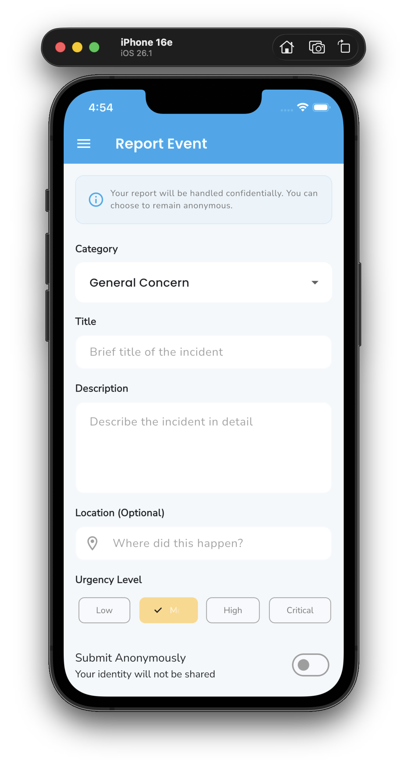
Community Engagement
Events Section
Browse upcoming agency events
Filter by category & audience
Event details with registration
Incident Reporting
Easy concern reporting form
Direct channel to agencies
Feedback System
Community feedback for continuous improvement

Slide 11
AI Chatbot Support
MAJOR ENHANCEMENT - AI-Powered Support System
Current Prototype
Why AI Integration Matters
Instant responses to common questions
Child protection information
Emergency resource direction
Friendly chat interface
Scalable support without human resource constraints
Consistent, evidence-based guidance
Accessible to families in remote areas
Reduces barrier to seeking help
Can be trained on local child protection laws & practices
Future AI Potential
LLM-powered intelligent responses
Voice support for low-literacy users
Multi-lingual conversations (EN + DZ)
Personalized parenting guidance
24/7 availability for urgent questions
A game-changer for child protection outreach at scale

Slide 12
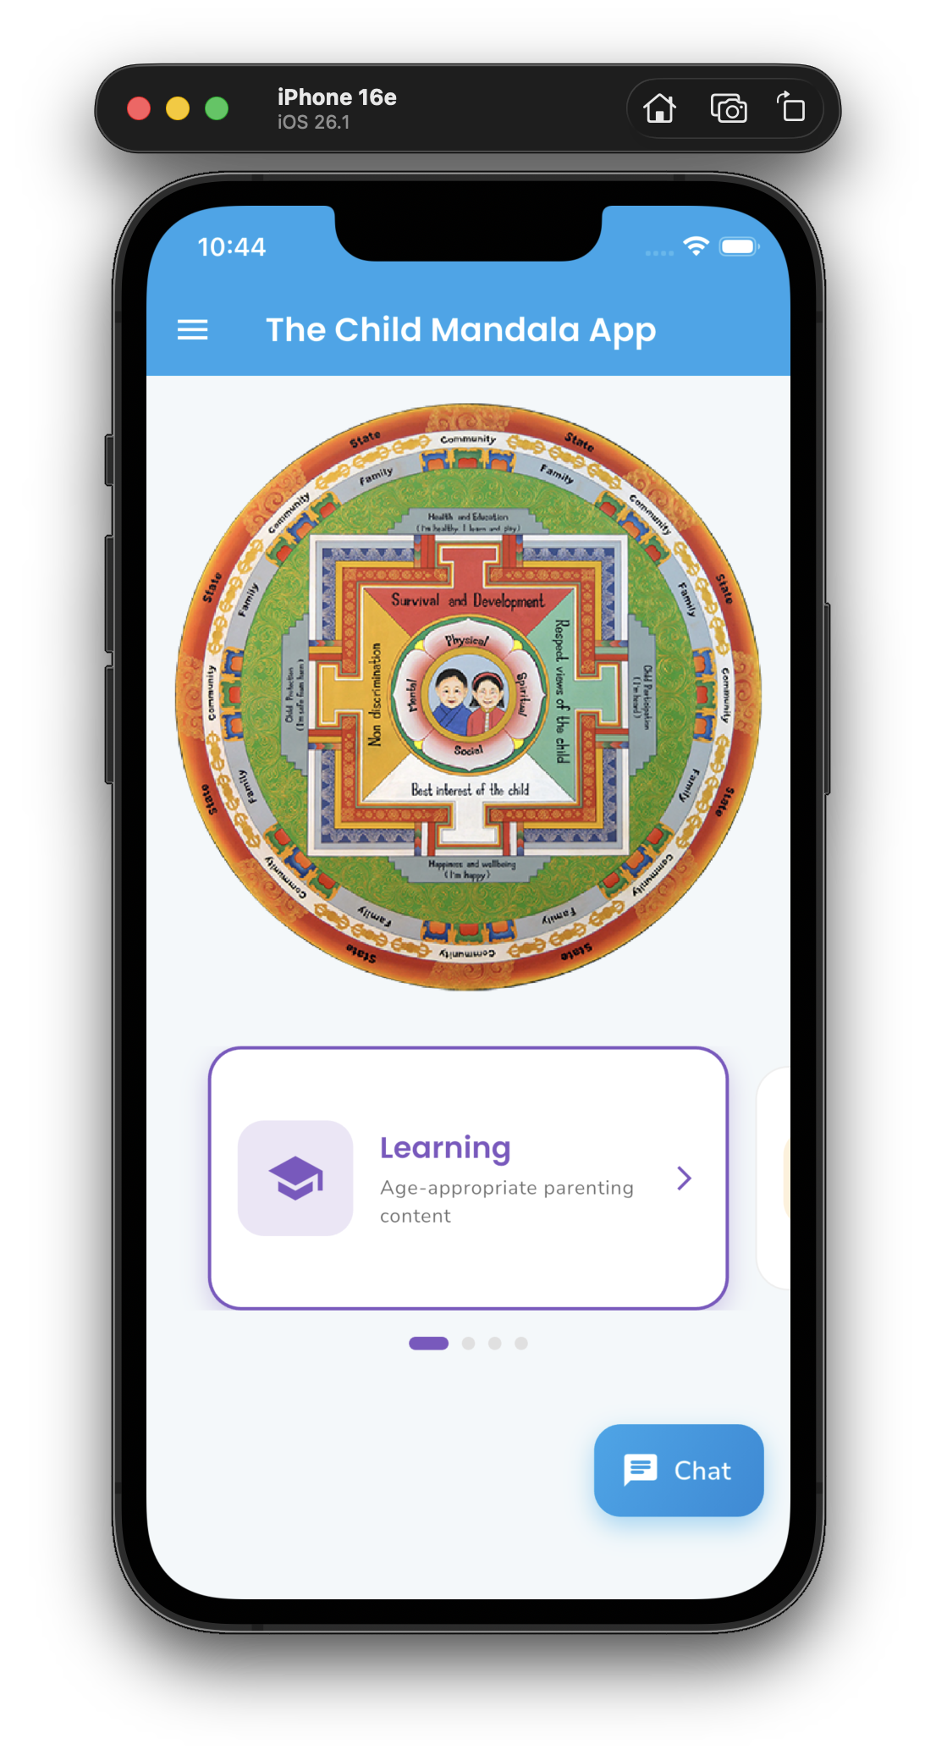
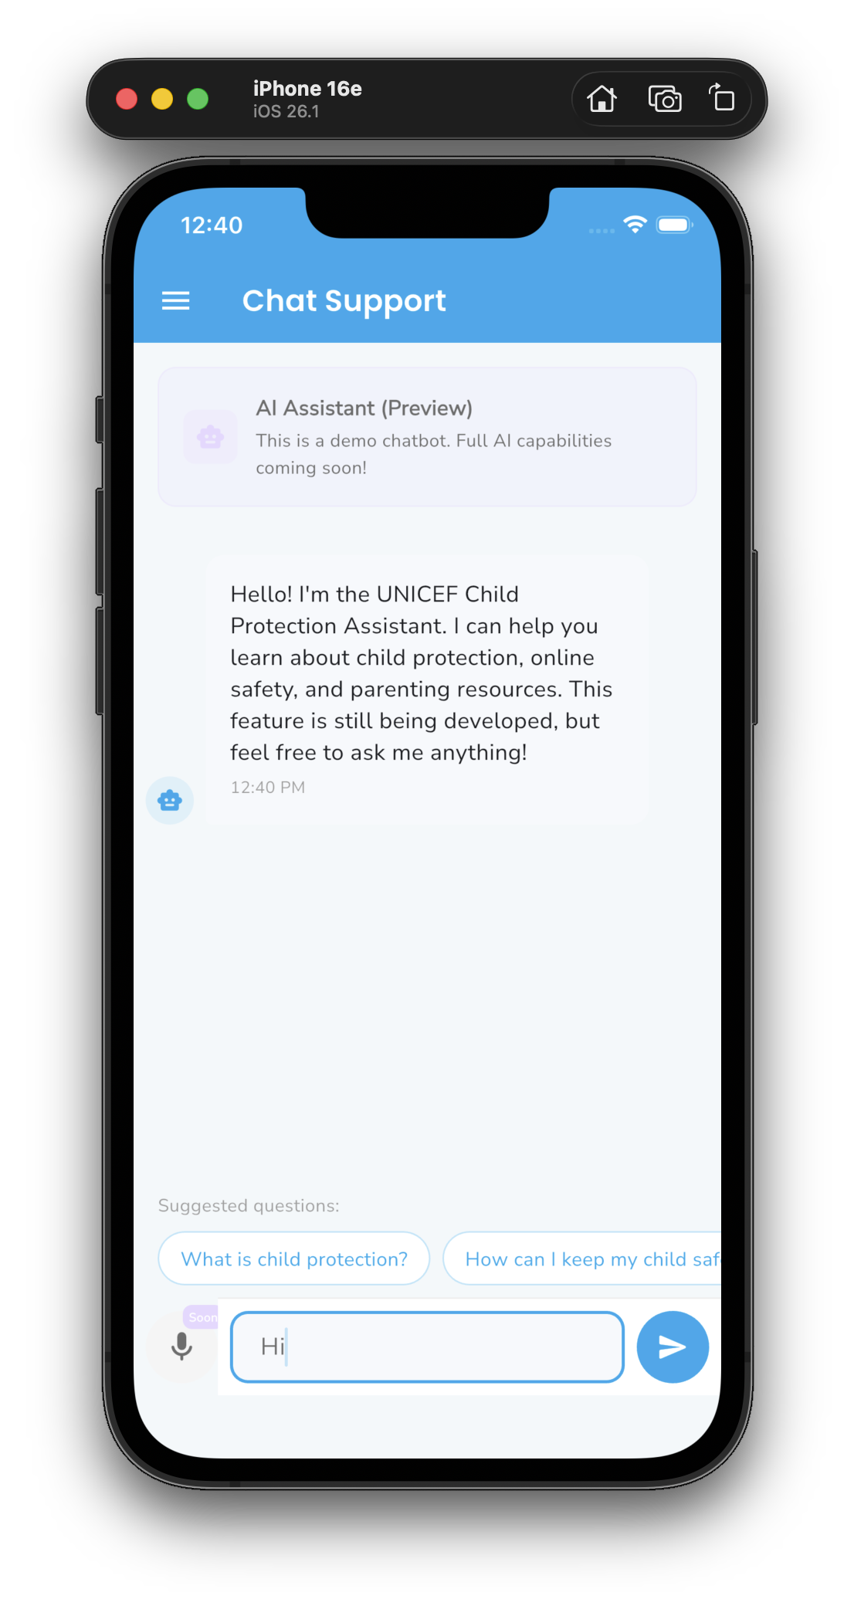
AI Chatbot Support
MAJOR ENHANCEMENT - AI-Powered Support System
Future AI Potential

Slide 13
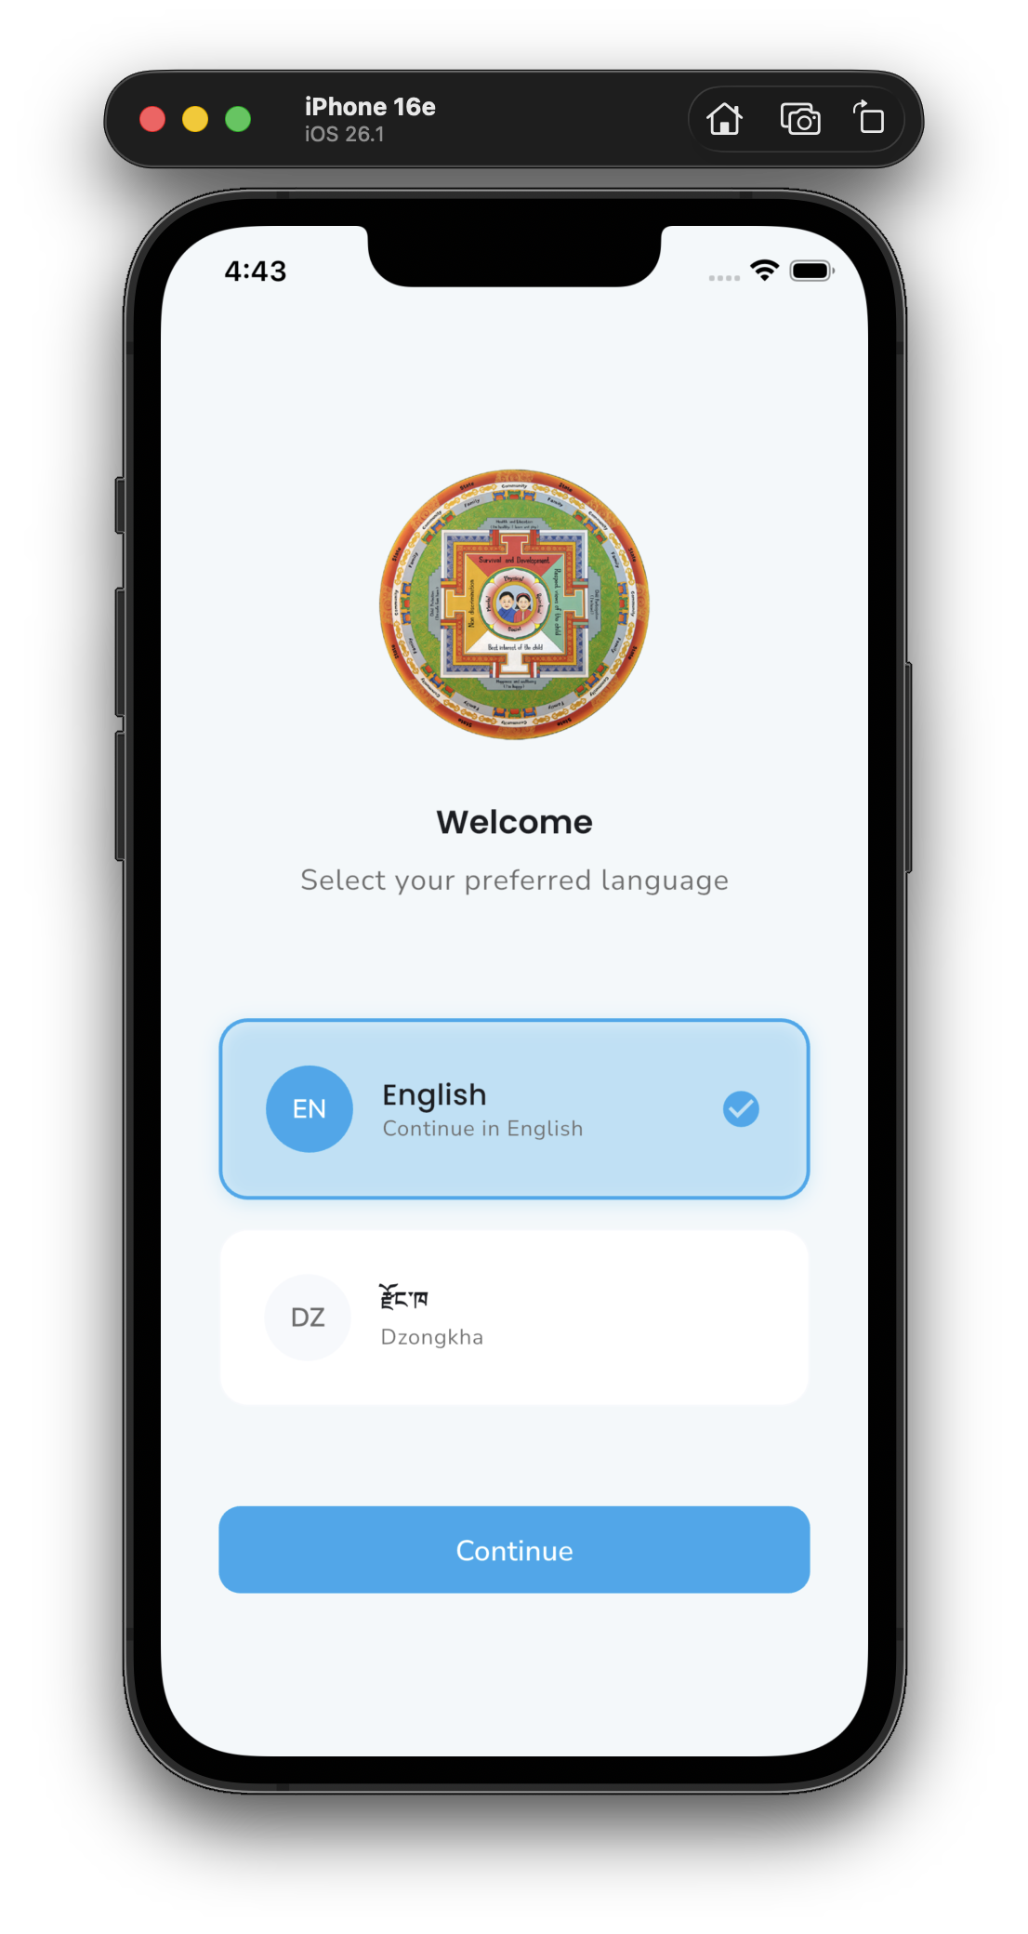
Bilingual Support
Languages
English
Dzongkha
Primary, fully implemented
National language, ready
Implementation
100+ UI strings localized
Language selection on first launch
Switch language anytime in settings
Content files prepared for translation
Impact: Rural families can access all features

Slide 14
System Architecture Overview
End-to-End Content Flow
ADMIN CMS
→
BACKEND API
→
MOBILE APP
Web Portal
REST/JSON
1. Admin CMS
2. Backend API
3. Mobile App
Web portal for content managers

Slide 15
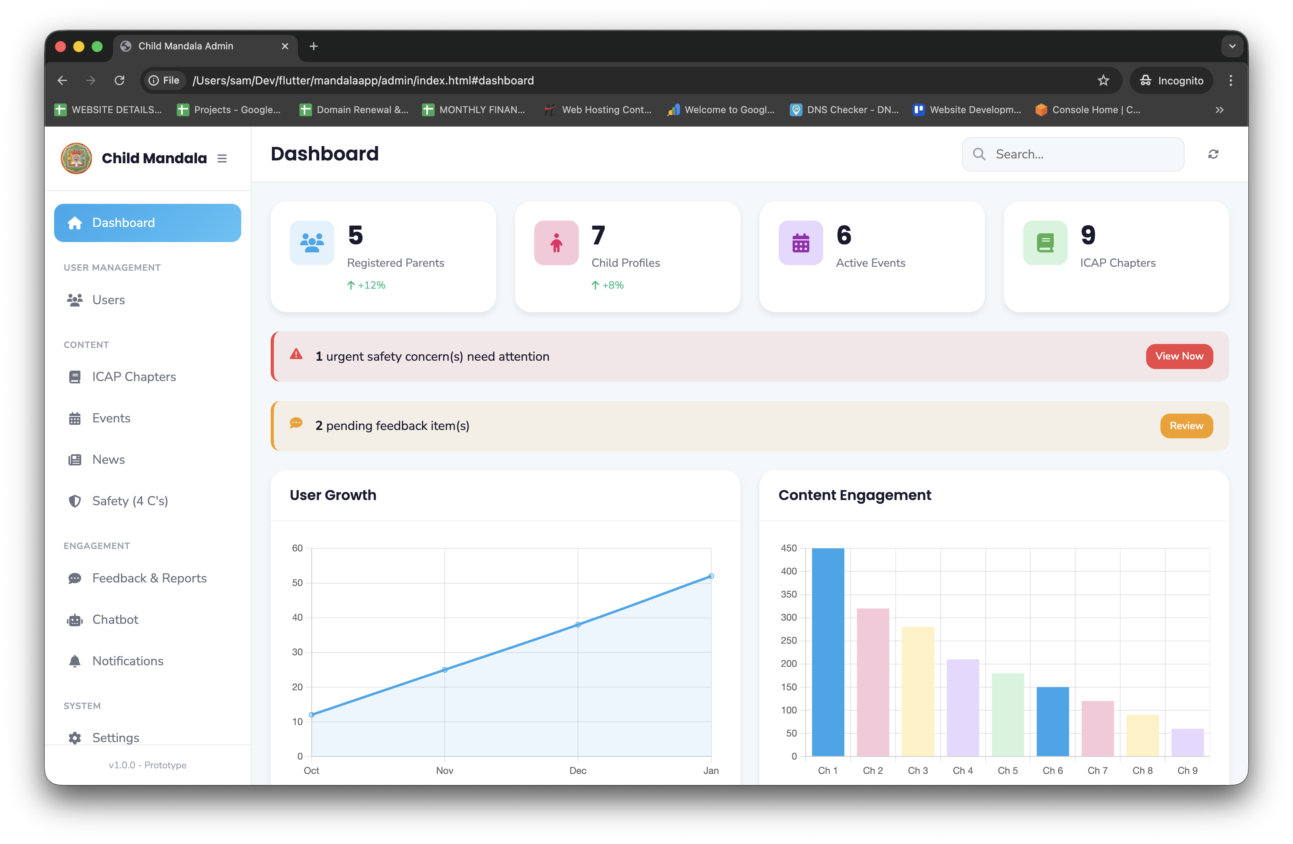
Backend Content Management System
Who Uses It
Key Capabilities
UNICEF content editors
Partner agency staff (events)
Translators (Dzongkha content)
System administrators
Feature | Description
Content Editor | Rich markdown editor with preview
Media Library | Upload images, link YouTube videos
Multi-language | Side-by-side EN/DZ editing
Age Targeting | Select which age groups see content
Publish Workflow | Draft → Review → Publish
Version History | Track all changes with rollback

Slide 16
Content Types Managed via Backend
Content Type | Admin Actions | App Display
ICAP Chapters | Add/edit chapters, topics, YouTube videos | Learning section with age filtering
Events | Create events, set dates, registration links | Events calendar with filters
News/Articles | Write articles, add images, categorize | News feed
Safety Content | Update 4 C's topics, tips, contacts | Online Safety hub
Chatbot | Add Q&A pairs, update intents | Chatbot conversations
Content Updates Without App Update
All content changes reflect immediately in app
No app store approval needed for content updates
Dzongkha translations can be added anytime

Slide 17
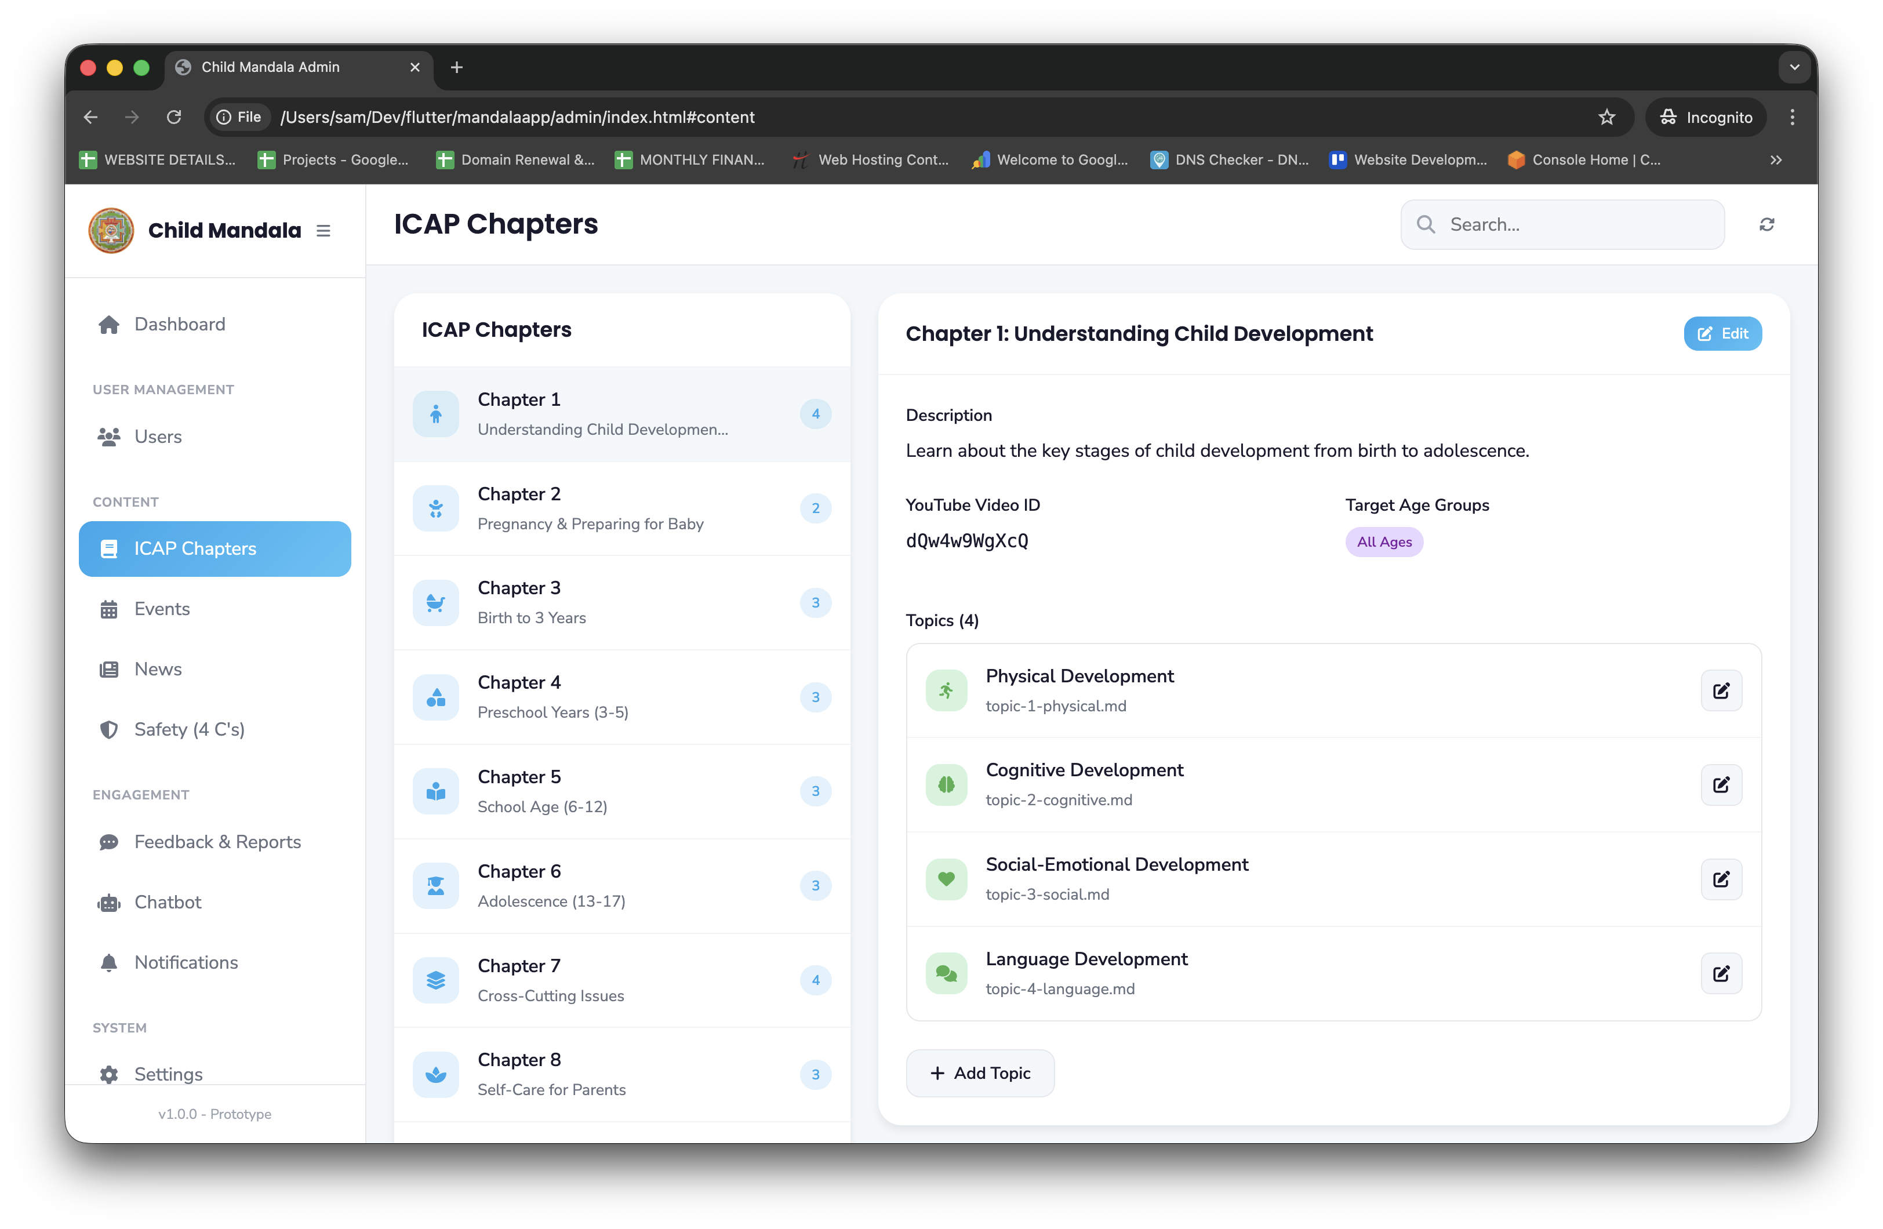
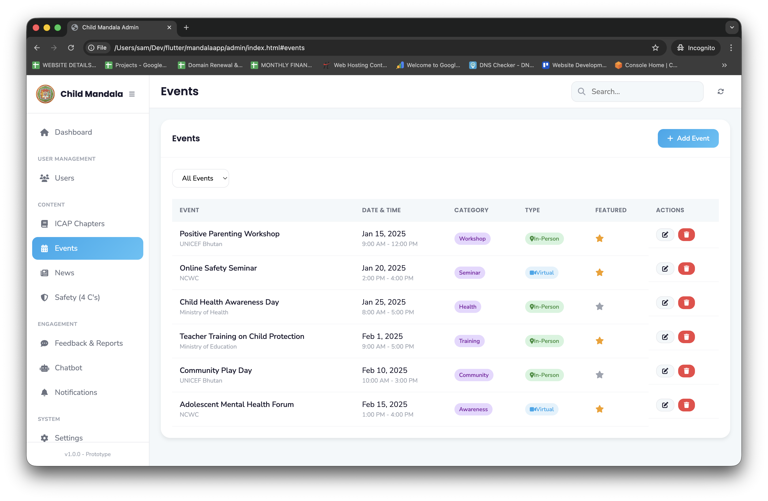
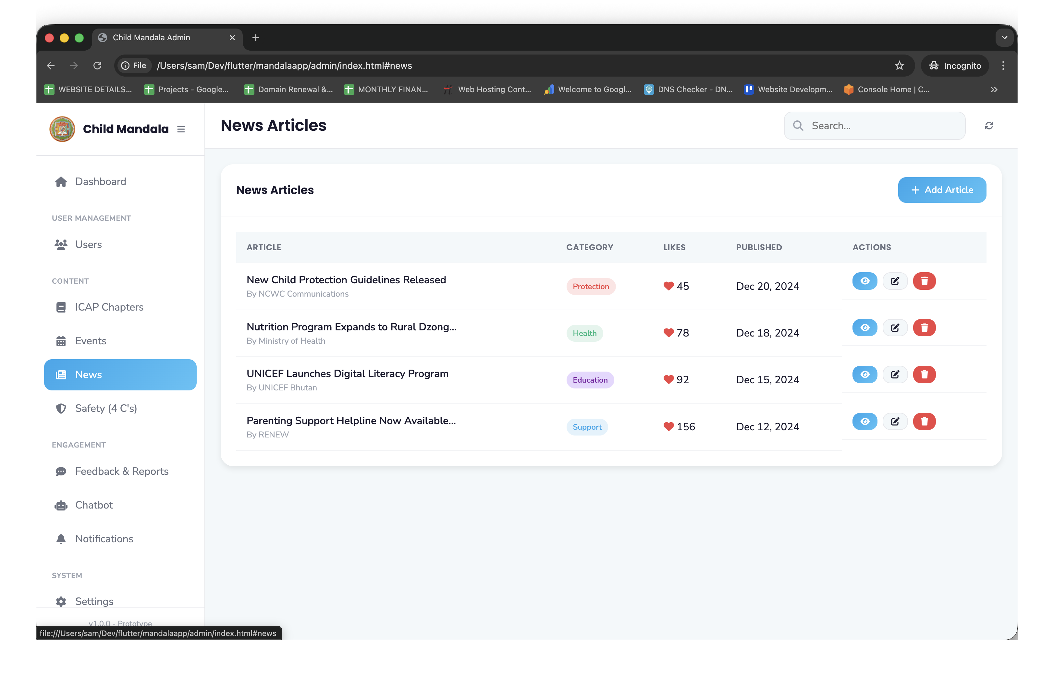
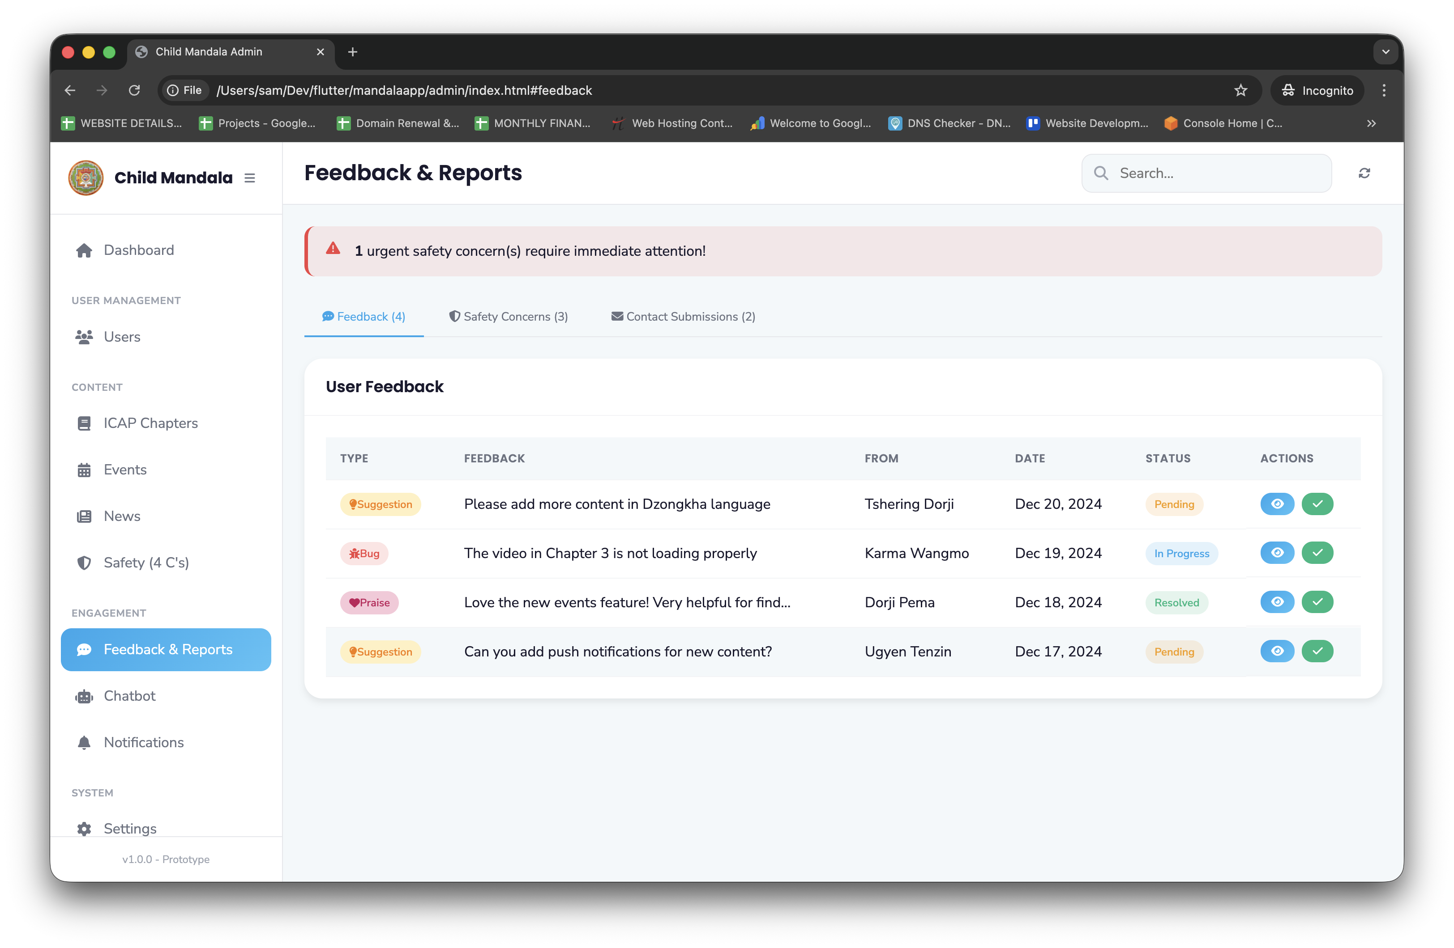
Content Types Managed via Backend

Slide 18
ICAP Content Workflow
1
2
3
Author Creates Content
Review & Publish
App Receives Content
Title & Description (EN + DZ)
YouTube Video ID
Age Groups (checkboxes)
Topics with markdown content
Save as Draft
Reviewer checks content accuracy
Preview in app simulator
Approve and publish
API delivers chapters filtered by age
Content cached locally for offline
Automatic sync when online

Slide 19
Events Management Workflow
Title, Description
Date, Time (start/end)
Location OR Virtual Link
Category (Seminar, Workshop, Training)
Target Audience (Parents, Children, Educators)
Hosting Agency (UNICEF, NCWC, MOH, MOE)
Registration URL
Featured flag (shows in carousel)
Image upload
Event Creation Fields
Multi-Agency Support
Each partner agency can have editor access
Events tagged by hosting organization
Filter by agency in app

Slide 20
Content Localization Workflow
1
2
3
Content Created in English
Translator Adds Dzongkha
Review & Publish
Editor writes chapter/topic in English
Saves and marks "Ready for Translation"
Side-by-side editor view
English on left, Dzongkha on right
Character count comparison
Translation status tracking
Both languages reviewed
Published together or English first
App Language Selection
User selects at first launch
Can switch anytime

Slide 21
Admin Dashboard & Analytics
Dashboard Metrics
Content Management
Total active users (parents + children)
Content views by chapter/topic
Most popular events
Safety concerns submitted
User feedback scores
Language distribution
Published vs. Draft content counts
Missing translations indicator
Upcoming events calendar
Recent user feedback queue
Reports
Monthly usage reports
Age group distribution
Geographic reach
Event attendance tracking

Slide 22
Stakeholder Benefits
For Families
For UNICEF
Free, trusted parenting resource
Available 24/7 on their phones
Content grows with their children
Safety education and reporting
Scalable child protection platform
Measurable awareness outcomes
Community engagement data
Foundation for regional expansion
For Government
For Partner Agencies
Aligned with national priorities
Cross-sector convergence tool
Digital transformation showcase
Cost-effective reach
Event publishing platform
Direct community connection
Incident reporting channel

Slide 23
Demo: See It In Action
App Demo Flow
Backend Demo (if available)
1. Language selection → Parent login (OTP)
2. Add child with DOB → Age group assignment
3. Child login with PIN → Age-filtered content
4. ICAP chapter with YouTube + expandable topics
5. Online safety section → Report concern
6. Events browsing
7. Chatbot interaction
Admin login → Content dashboard
Create/edit ICAP chapter
Add event with agency tagging
View analytics

Slide 24
Next Steps & Call to Action
Immediate Next Steps
What We Need
1. Stakeholder feedback on prototype
2. Backend CMS development kickoff
3. Content review and Dzongkha translation planning
4. Partner agency onboarding for events
Approval to proceed with backend development
Content translation resources
Partner agency access credentials
YouTube video content for chapters
Testing devices and feedback
Let's protect Bhutan's children together

